Slide 1

“Calorie Capturers”
- Vishwajeet Vishwakarma
-Somesh Fengade
-Shubham Varma
-Suchit Jain

Slide 2
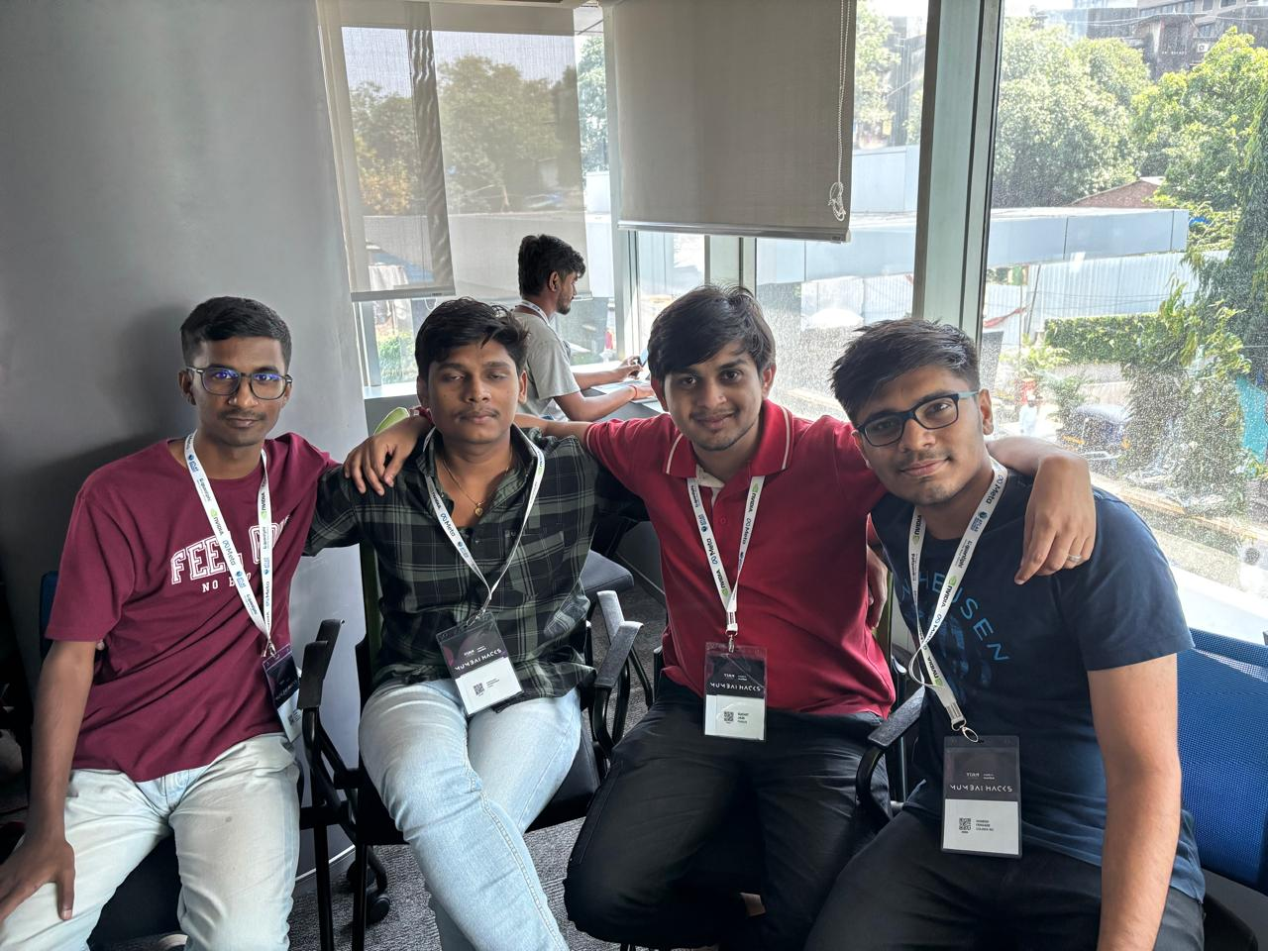
Team Photo

Slide 3
Problem
"With the rise in health consciousness, understanding food’s nutritional impact is crucial. This project introduces an Android app and web based app powered by the Llama model, which analyzes food images to estimate calorie content and provides actionable suggestions for calorie burn. The solution empowers users to make informed dietary choices conveniently, promoting healthier habits in a tech-savvy manner."

Slide 4
Solution
To provide users with a seamless and interactive experience, this project combines powerful technologies across the frontend and backend:
Frontend (Next.js,React Native App): A user-friendly, cross-platform interface allows users to capture or upload food images. React Native ensures the app works smoothly on both Android and iOS devices, enabling wider reach and accessibility.
Backend (FastAPI): FastAPI handles image processing requests, routing the data efficiently to the Llama model for analysis. Its high performance and asynchronous support allow for quick response times, enhancing the user experience.
AI Model (Llama Model): The Llama model analyzes the food images to detect the type and quantity of food, estimating calorie content based on predefined data. It then generates a personalized description and suggests effective ways to burn those calories, guiding users toward healthier choices.

Slide 5
Competitive Advantage
This project offers real-time calorie analysis through image recognition, enabling users to track their intake effortlessly. By providing personalized calorie-burning suggestions based on food consumption, it fosters a holistic approach to health. The user-friendly Next.js and React Native interface ensures accessibility across devices, while the integration of the Llama model enhances accuracy in nutritional assessments. Overall, the app combines convenience and advanced technology, setting it apart in the health and wellness market.

Slide 6
Business Model
1. Freemium Model: The app will be available for free with basic features, allowing users to analyze food images and receive calorie estimates. Premium features, such as advanced nutritional insights, customized meal plans, and exclusive workout suggestions, will be offered via a subscription.
2. Partnerships with Health & Fitness Brands: Collaborating with fitness centers, nutritionists, and health food brands can provide users with discounts or promotions, creating additional revenue streams through affiliate marketing.
3. In-App Advertising: The app can generate revenue through targeted advertisements from health and wellness brands, ensuring that ads align with user interests.

Slide 7
Business Model
4. Data Analytics Services: Aggregate and anonymized user data can be offered to health and fitness companies for market research and product development, ensuring privacy compliance while creating additional revenue opportunities.
5. Corporate Wellness Programs: The app can be marketed to businesses looking to promote employee wellness, offering tailored solutions for workplace health initiatives.

